Slide 1
Memory Partitioning in OS
Name | Gr. Number | Roll Number
Siddarth Rakshe | 22010150 | 331051
Siddesh Dharmadhikari | 22120033 | 331066
Mohit Deshpande | 22120062 | 331068
Om Bhavsar | 22120084 | 331069

Slide 2
Contents
Introduction
Objectives
Fixed memory Partitioning
Dynamic memory partitioning
Paging : - Hardware
Segmentation
Example of paging

Slide 3
Introduction
Memory partitioning is the system by which the memory of a computer system is divided into sections for use by the resident programs. These memory divisions are known as partitions. There are different ways in which memory can be partitioned: fixed, dynamic partitioning.
Paged memory management: Memory is divided into fixed-sized units called page frames, used in a virtual memory environment.
Segmented memory management: Memory is divided into different segments (a segment is a logical grouping of the process’ data or code).In this management, allocated memory doesn’t have to be contiguous.

Slide 4
Objectives
To get basic idea about Memory Partitions
Fixed size partitioning
Dynamic Partitioning
Fragmentation
Paging
Segmentation
Real life Example

Slide 5
Fixed Size Partitioning
The earliest and one of the simplest technique which can be used to load more than one processes into the main memory is Fixed partitioning or Contiguous memory allocation.
In this technique, the main memory is divided into partitions of equal or different sizes. The operating system always resides in the first partition while the other partitions can be used to store user processes. The memory is assigned to the processes in contiguous way.
In fixed partitioning
The partitions cannot overlap.
A process must be contiguously present in a partition for the execution.

Slide 6
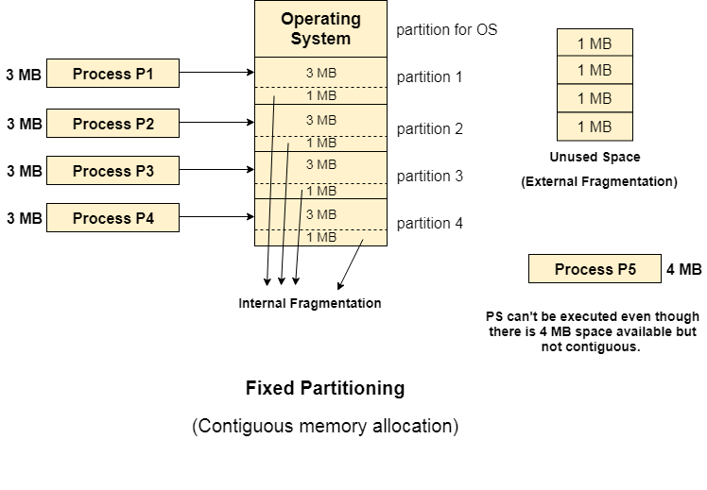
Example of Fixed Partitioning

Slide 7
Dynamic Size Partitioning
It is a part of Contiguous allocation technique. It is used to alleviate the problem faced by Fixed Partitioning. In contrast with fixed partitioning, partitions are not made before the execution or during system configure. Various features associated with variable Partitioning-
Initially RAM is empty and partitions are made during the run-time according to process’s need instead of partitioning during system configure.
The size of partition will be equal to incoming process.
The partition size varies according to the need of the process so that the internal fragmentation can be avoided to ensure efficient utilisation of RAM.
Number of partitions in RAM is not fixed and depends on the number of incoming process and Main Memory’s size.

Slide 8
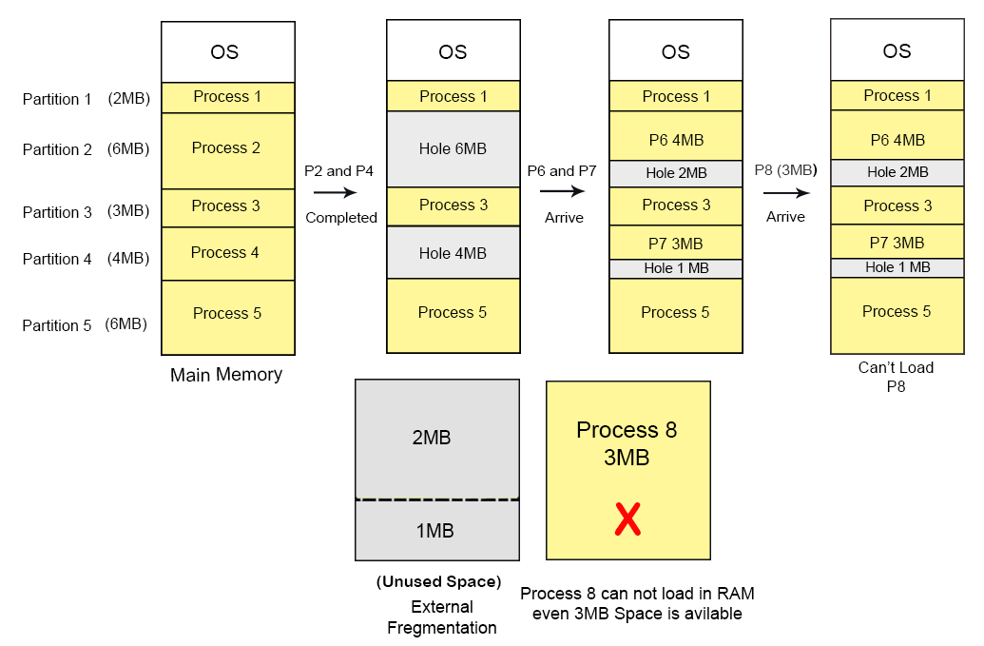
Example of Dynamic Size Partitioning

Slide 9
Paging
Paging is a storage mechanism that allows OS to retrieve processes from the secondary storage into the main memory in the form of pages.
In the Paging method, the main memory is divided into small fixed-size blocks of physical memory, which is called frames. The size of a frame should be kept the same as that of a page to have maximum utilization of the main memory and to avoid external fragmentation.
Paging is used for faster access to data, and it is a logical concept.

Slide 10
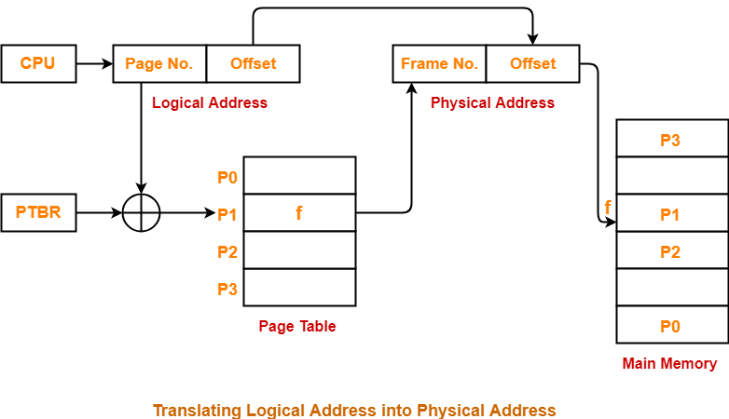
Example OF paging

Slide 11
Segmentation
In Operating Systems, Segmentation is a memory management technique in which the memory is divided into the variable size parts. Each part is known as a segment which can be allocated to a process.
The details about each segment are stored in a table called a segment table. Segment table is stored in one (or many) of the segments.
Segment table contains mainly two information about segment:
Base: It is the base address of the segment
Limit: It is the length of the segment

Slide 12
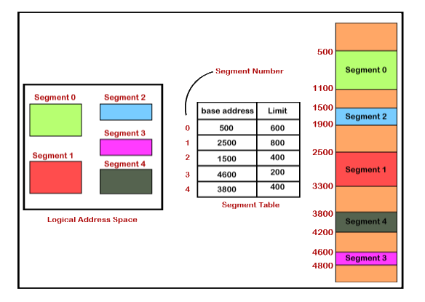
Example Of Segmentation

Slide 13
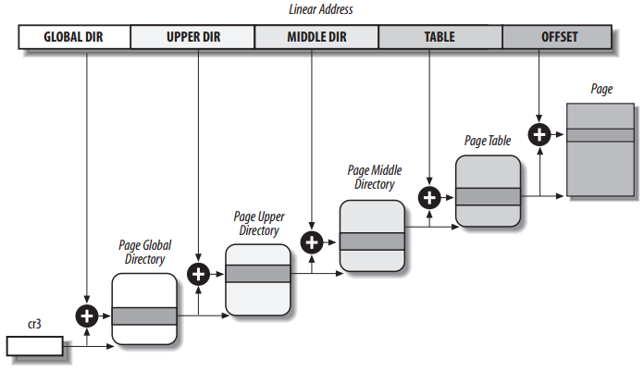
Paging in Linux

Slide 14
Linux adopts a common paging model suitable for both 32-bit, 64-bit architectures.
For Linux 2.6.11+, a four-level paging model has been adopted
Page Global Directory(PGD).
Page Upper Directory(PUC).
Page Middle Directory(PMD).
Page Table.
Modifications are made to ensure that the same code can work on both 32-bit and 64-bit architecture.
Each process has its own PGD and its own set of Page Tables. When a context switch occurs, Linux saves the control register in segment descriptor of the previous process and loads the same for next process. When the new process resumes its execution, the paging tables refers to correct set of Page Tables.

Slide 15
THANK YOU !!!!!

